Slide 1
C.S. Investigatory Project
Submitted By:- 1. Tushar 2. Dhruv

Slide 2


TOPIC
Library Management
Of The Project
SYSTEM

Slide 3
CERTIFICATE
This is to certify that Tushar Patel and Dhruv Gautam student of Class XII-Science KENDRIYA VIDALAYA NO-2 ARMY BHUJ has completed the project titled “LIBRARY MANAGEMENT SYSTEM” during the academic year 2020-2021 towards partial fulfillment of credit for the CS practical evaluation of CBSE 2021, and submitted satisfactory report, as compiled in the following pages, under my supervision.
Sh. B.L Kashyap
(PGT C.S)
Sh. Rajesh Trivedi
(Principal)
External Examiner

Slide 4
I am highly grateful to Mr. B.L Kashyap, our CS teacher, for his kind guidance and encouragement. Without his untiring help, it would not have been possible for me to perform this project. My special thanks to our respected principal Sh. Rajesh.Trivadi for his inspiration and motivation. Too many thanks to our willingly or unwilling contribution to this project and whose name do not appear here, I expected big thanks. I wish to thanks MY PARENTS for their undivided support & interest who inspired me & encouraged me to go my own way, without which I would be unable to complete my project. And at last by no means the least I would thanks to God who made the entire thing possible.
ACKNOWLEDGEMENT

Slide 5
INDEX
Python
Introduction
01
02
Requirements
Python Coding
03
04
Introduction to Python
Introduction about Project
Software Requirement
Coding of Project
05
06
Outputs
Bibliography

Slide 6
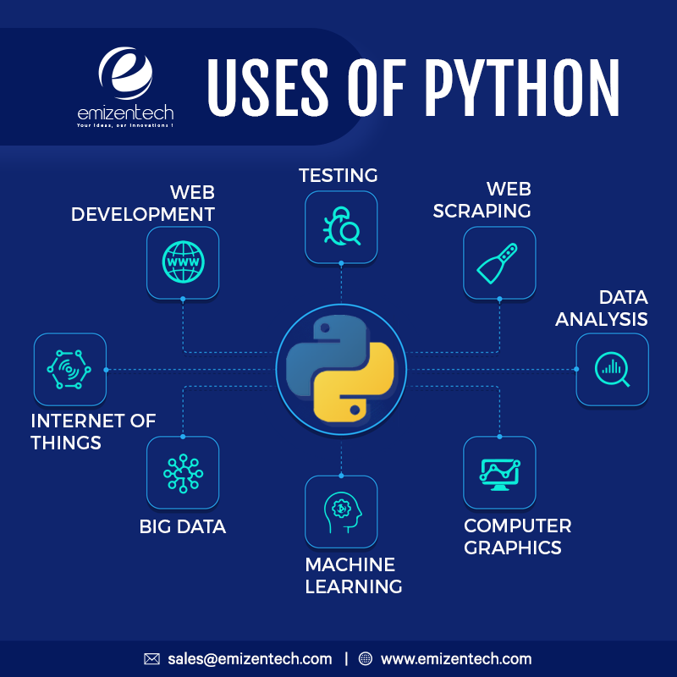
01
Python
Introduction

Slide 7

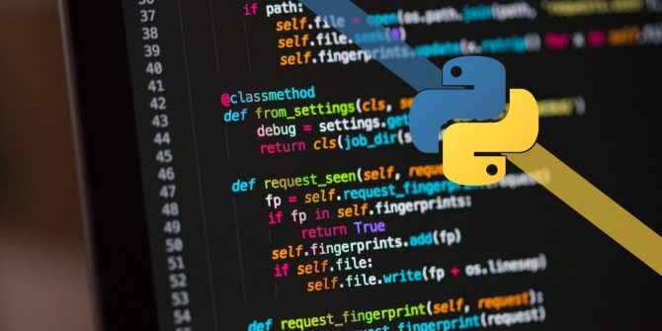
Python is a high-level, interpreted, interactive and object-oriented scripting language. Python is designed to be highly readable. It uses English keywords frequently where as other languages use punctuation, and it has fewer syntactical constructions than other languages.
Python is Interpreted − Python is processed at runtime by the interpreter. You do not need to compile your program before executing it.This is similar to PERL and PHP
Python is Interactive − You can actually sit at a Python prompt and interact with the interpreter directly to write your programs.
Python is Object-Oriented − Python supports Object-Oriented style or technique of programming that encapsulates code within objects.
Python is a Beginner's Language − Python is a great language for the beginner-level programmers and supports the development of a wide range of applications from simple text processing to WWW browsers to games

Slide 8

02
About The Project
Python
Introduction
Requirements
Python Coding
Outputs
Project Schedule
Project Timeline
Status Report
Bibliography
Upcoming Report
Intro.

Slide 9
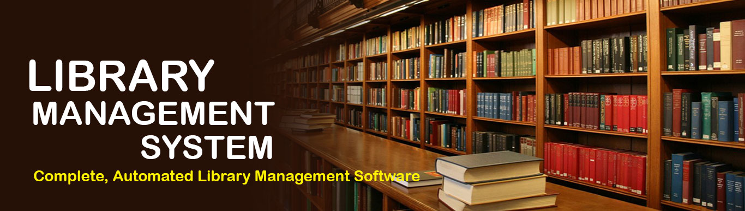
ABOUT THE PROJECT
Python
Introduction
Requirements
Python Coding
Outputs
Project Schedule
Project Timeline
Status Report
Bibliography
Upcoming Report
This project is Library management system for monitoring and controlling the transactions of Books in a library. “Library Management System” is a Python(Tkinter) application, designed to help users maintain and organize library Books. A library is a collection of sources of information and similar resources, made accessible to a defined community for reference or borrowing. This System keeps track of all the information about the Transaction of books in the library. The user will find it easy in this automated system rather than using the manual writing system. The system contains a database where all the information about the user will be saved safely. This project is designed And coded in Python(Tkinter) and Database management is handled by MySQL.

Slide 10

03
Requirements
Python
Introduction
Requirements
Python Coding
Outputs
Project Schedule
Project Timeline
Status Report
Bibliography
Upcoming Report
Software Requirement

Slide 11
Python
Microsoft Power Point
Python
Introduction
Requirements
Python Coding
Outputs
Project Schedule
Project Timeline
Status Report
Bibliography
Upcoming Report
Software Requirements
OS
Mysql.connector
Tkinter
Version – 2007 or Above

Slide 12

04
CODING
Python
Introduction
Requirements
Python Coding
Outputs
Project Schedule
Project Timeline
Status Report
Bibliography
Upcoming Report
START

Slide 13
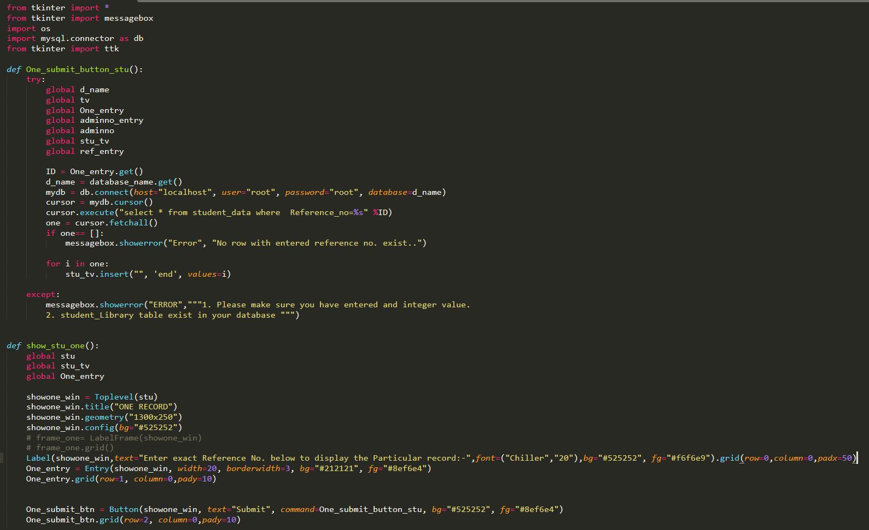
Python
Introduction
Requirements
Python Coding
Outputs
Project Schedule
Project Timeline
Status Report
Bibliography
Upcoming Report
CODING

Slide 14
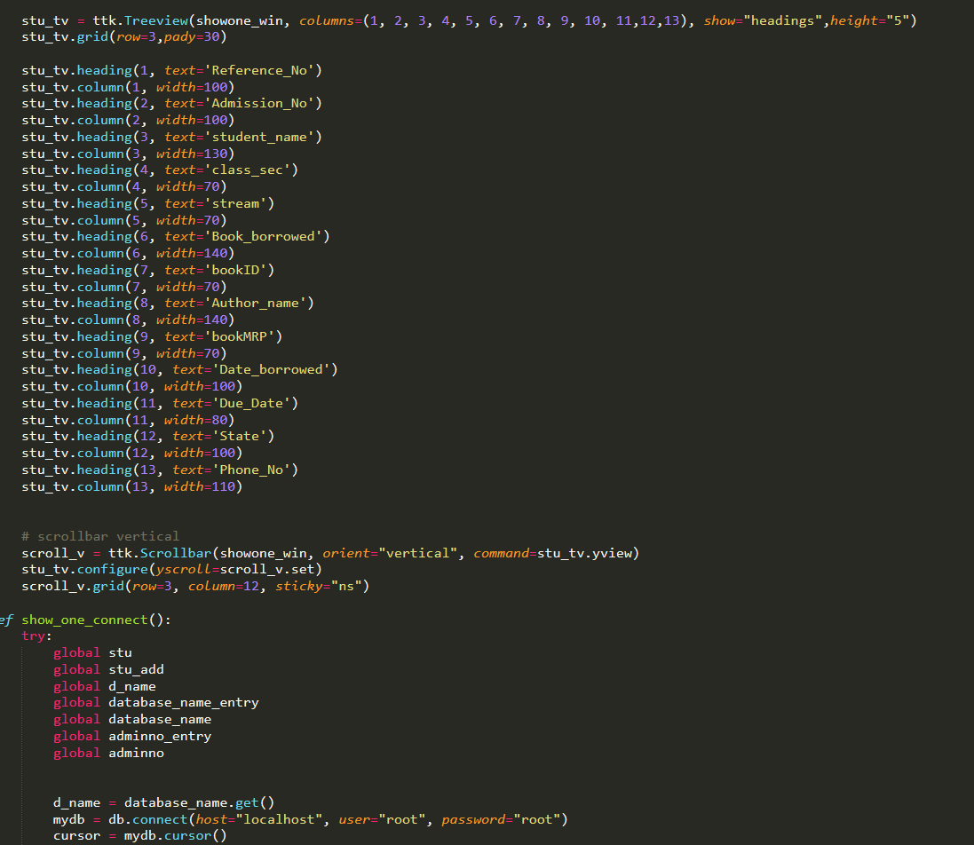

Slide 15
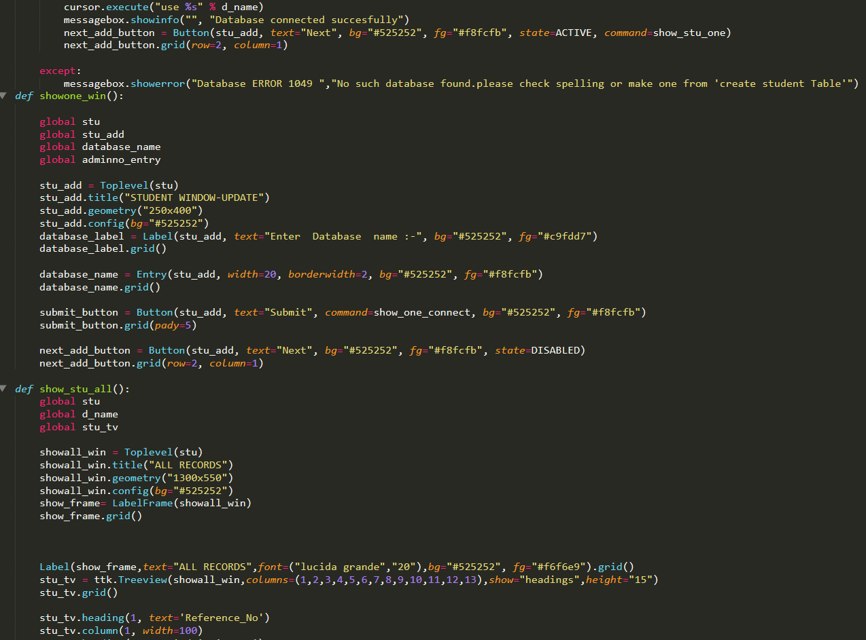

Slide 16
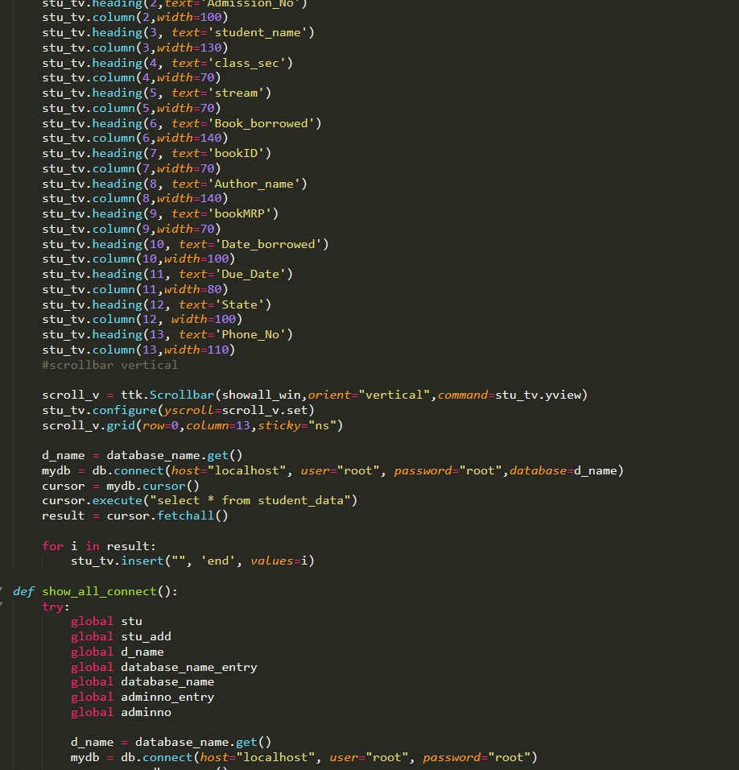

Slide 17
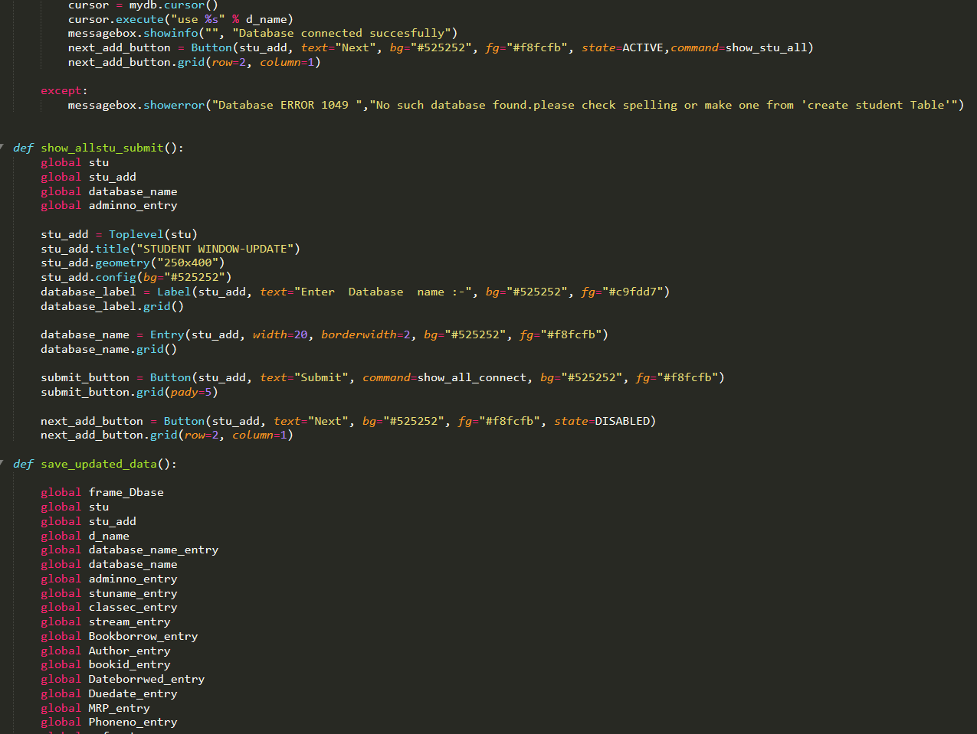

Slide 18
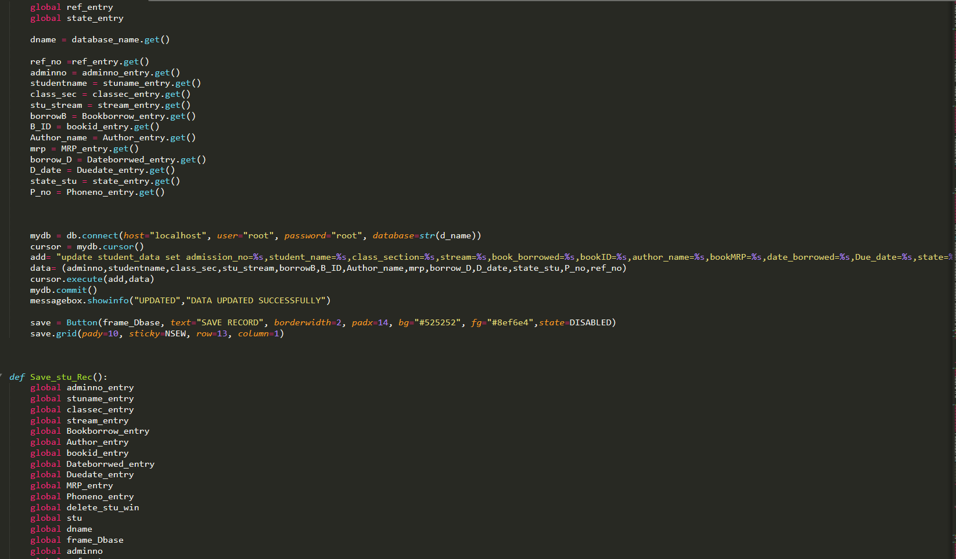

Slide 19
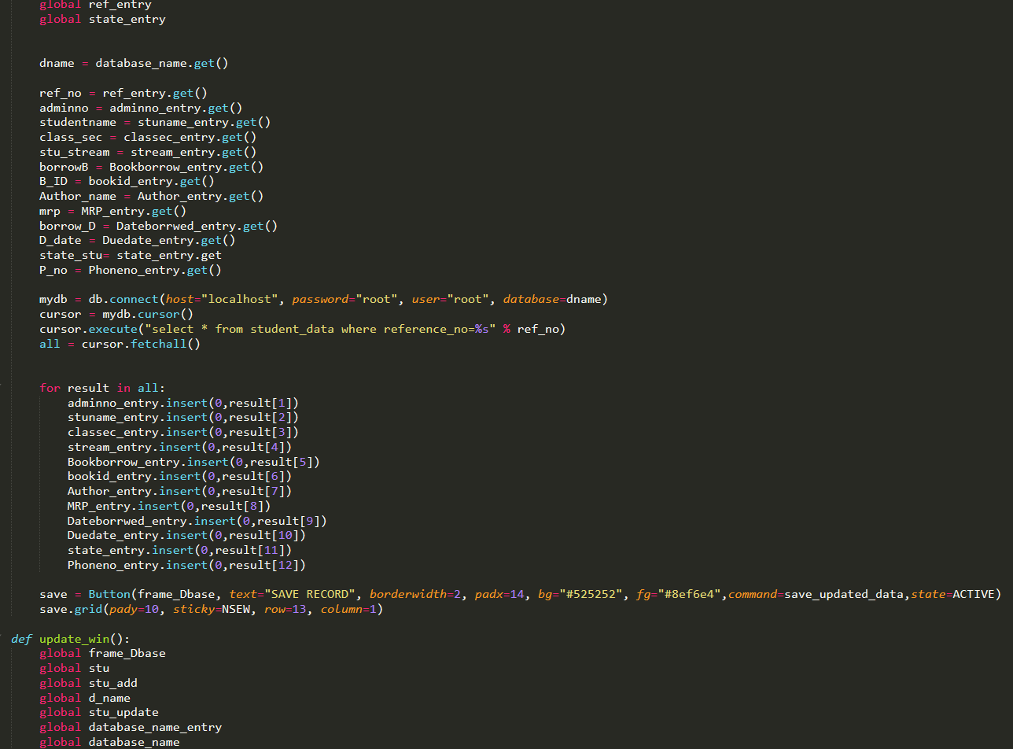

Slide 20
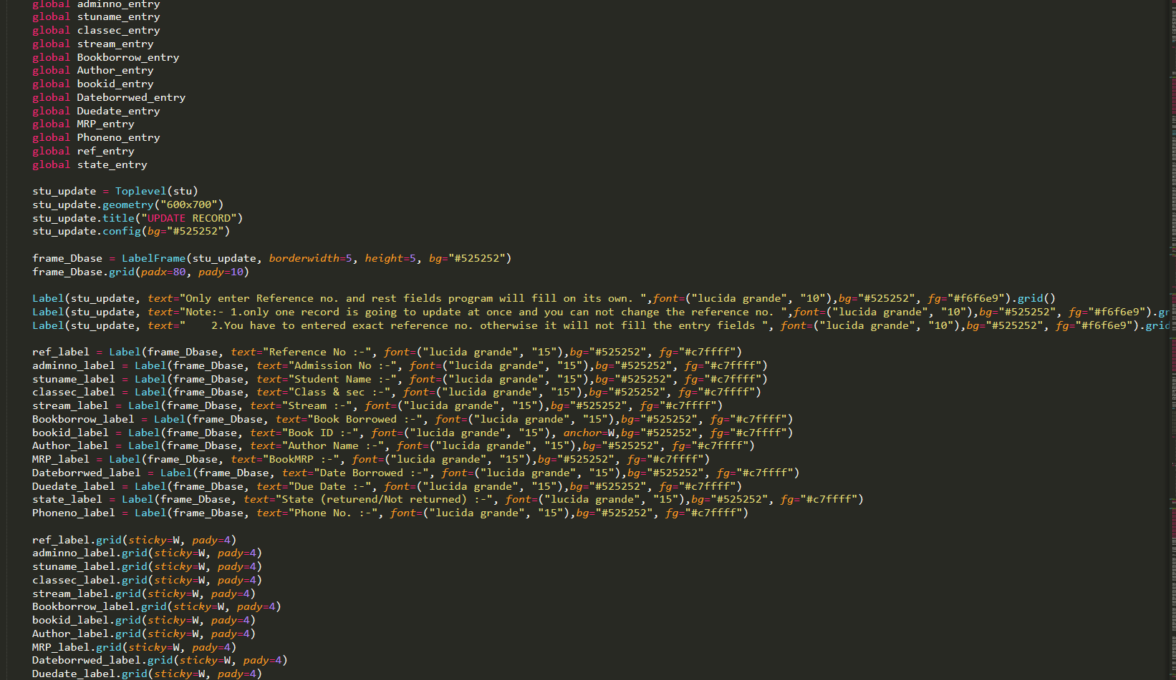

Slide 21
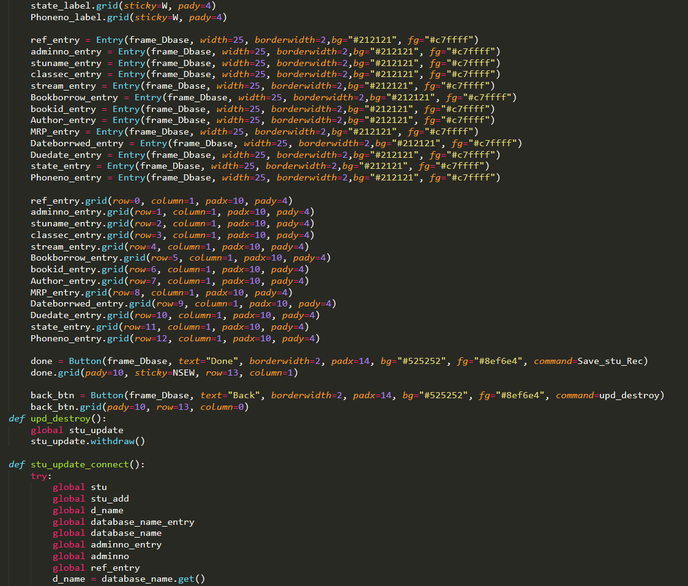

Slide 22
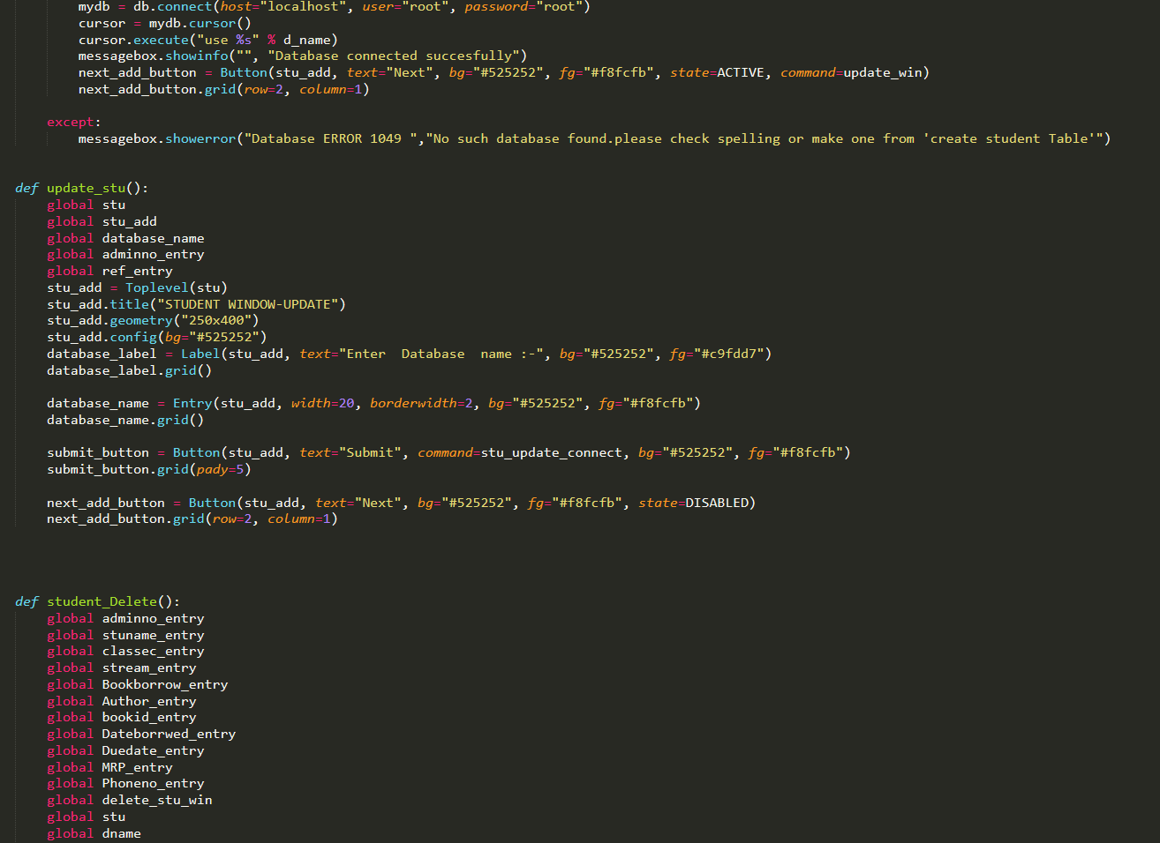

Slide 23
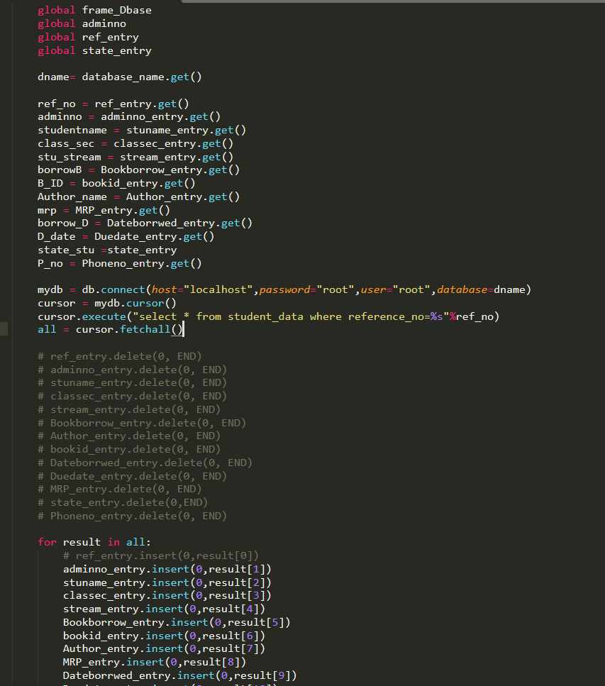

Slide 24
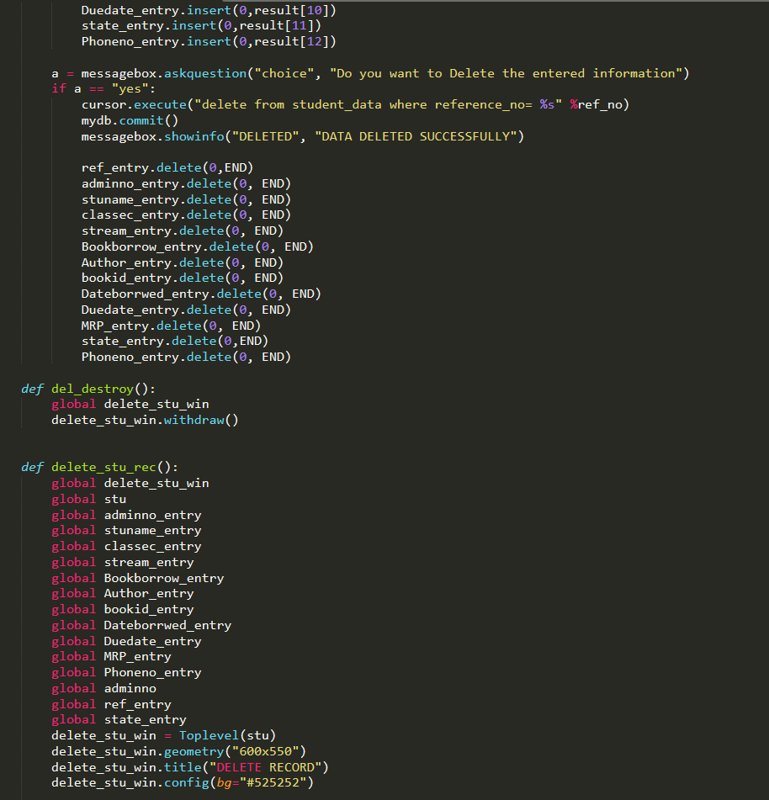

Slide 25
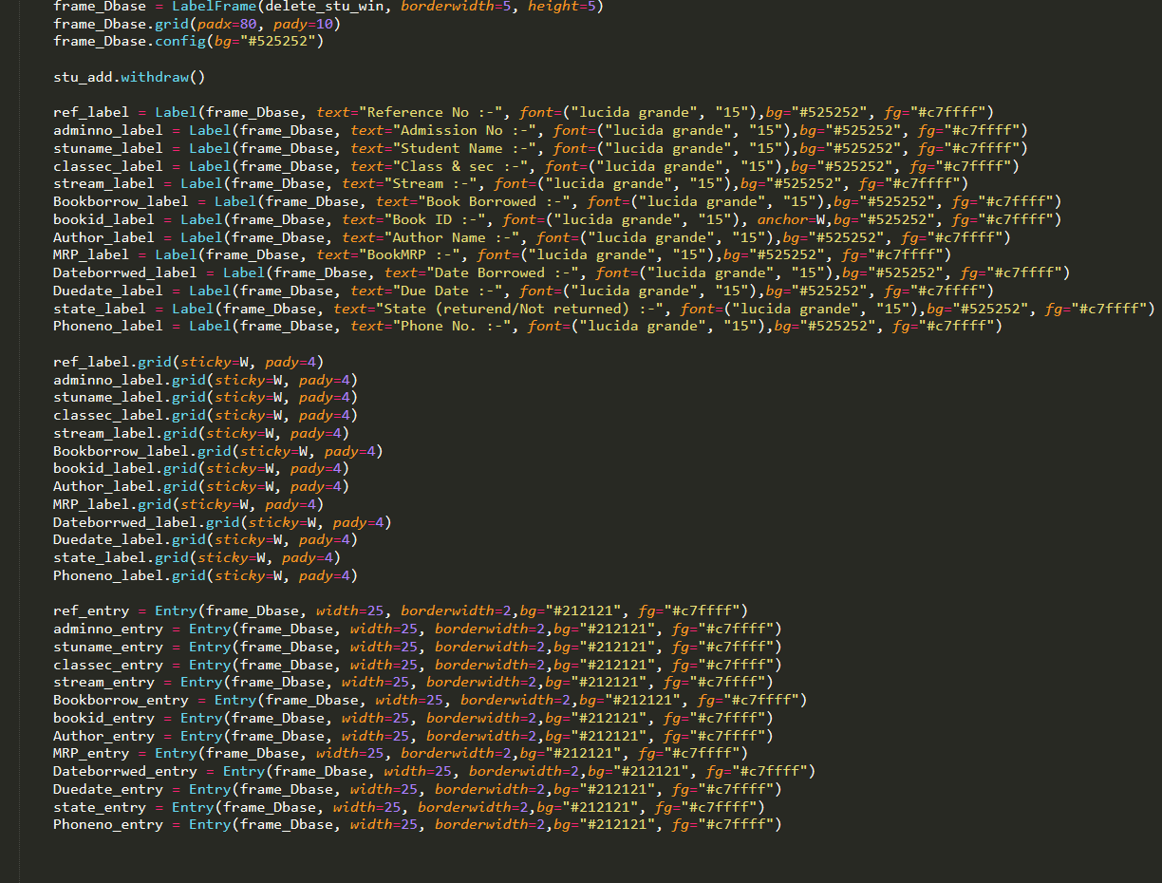

Slide 26
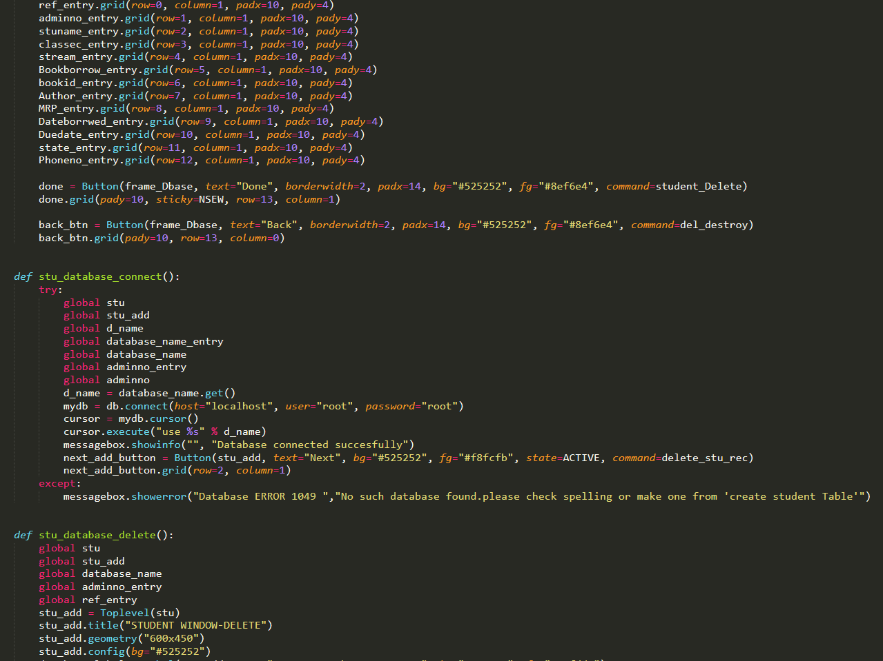

Slide 27
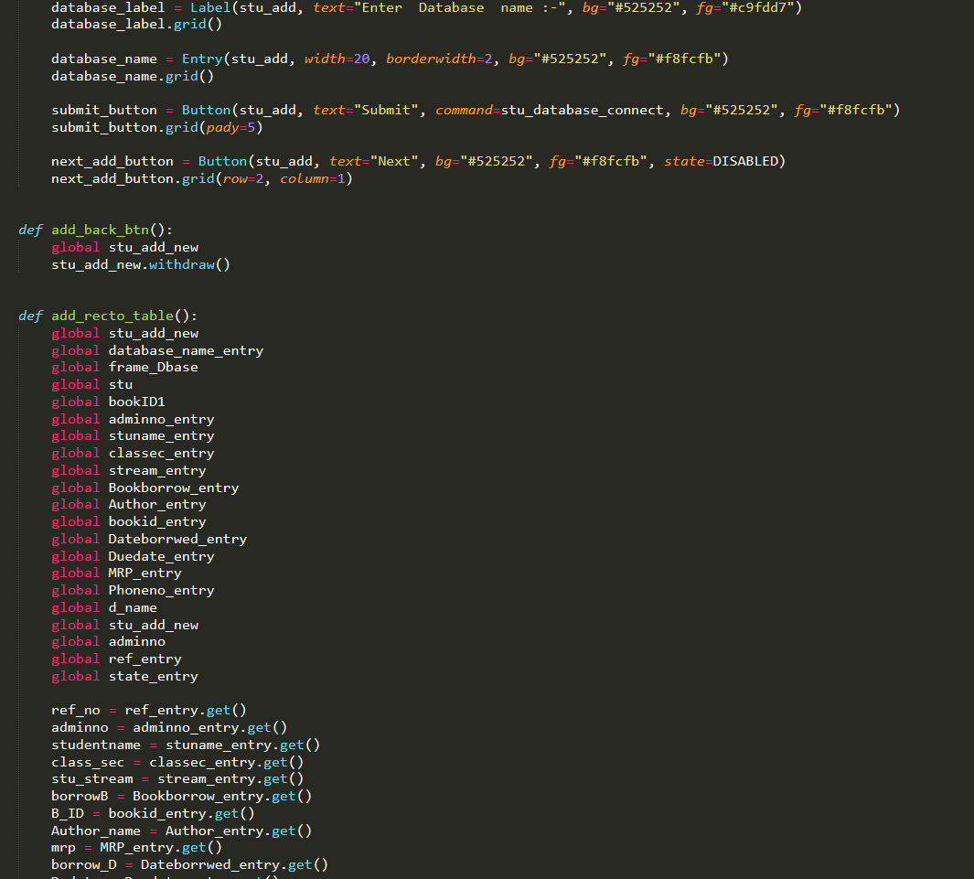

Slide 28
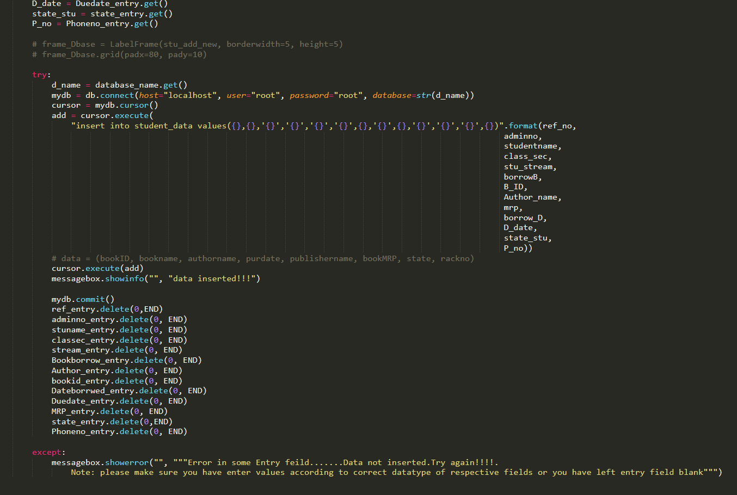

Slide 29
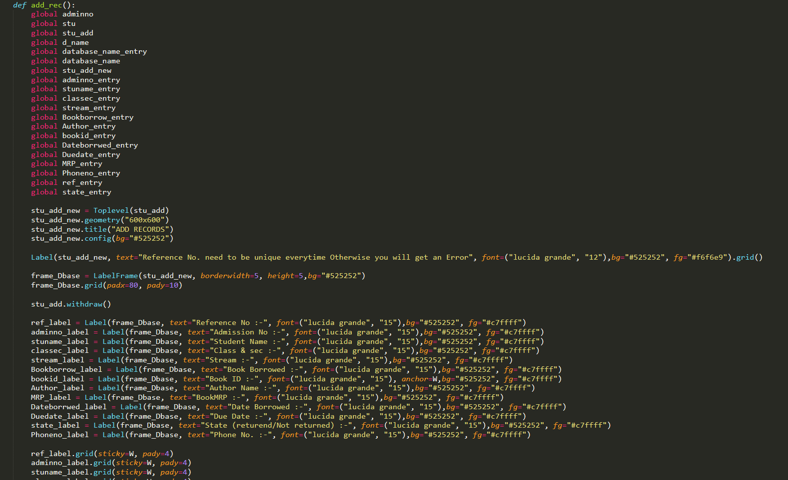

Slide 30
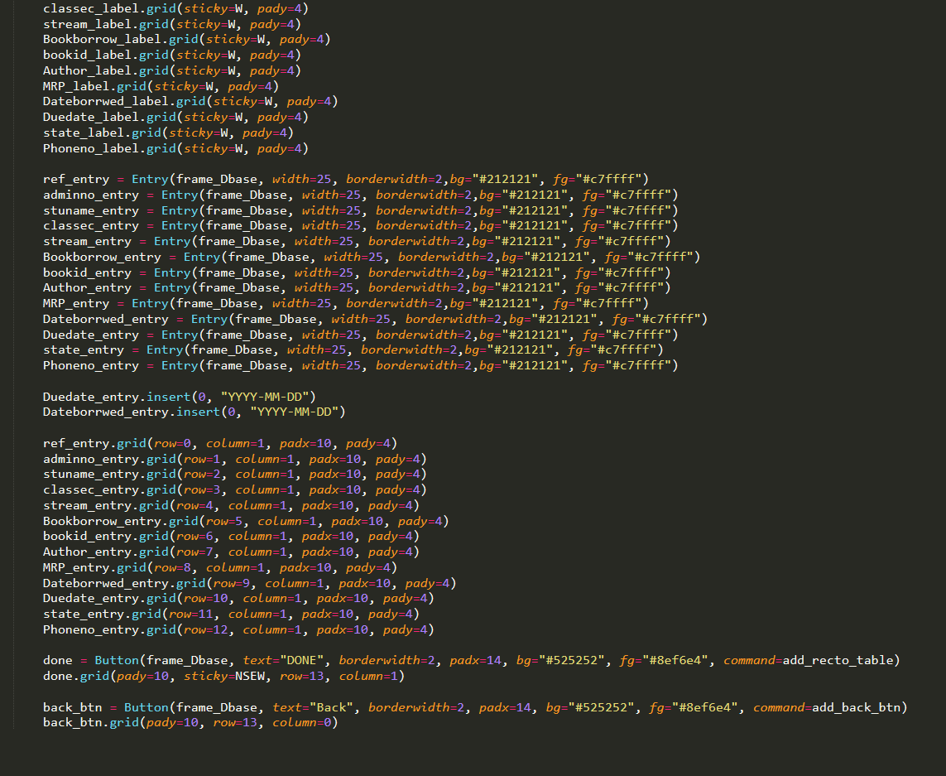

Slide 31
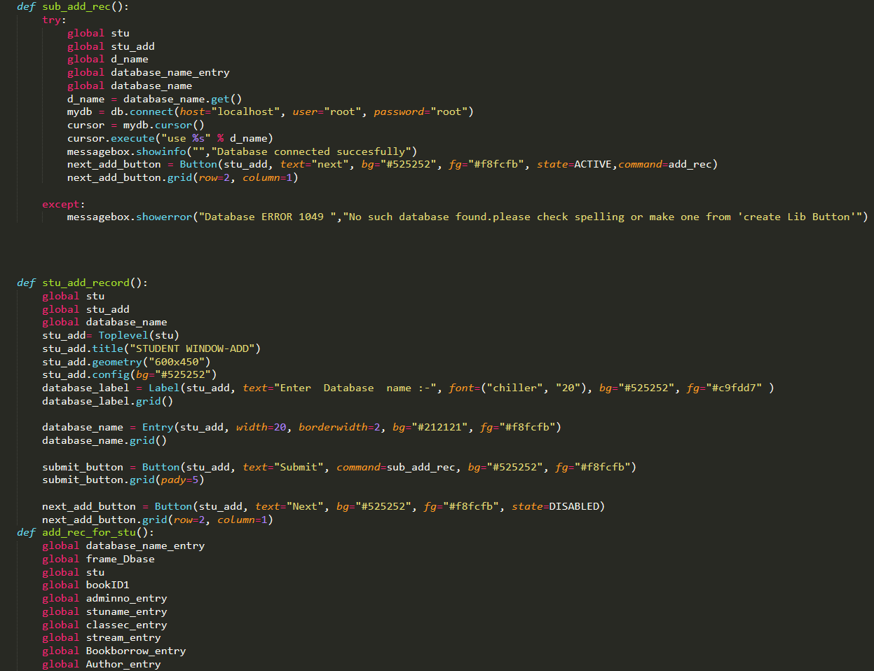

Slide 32
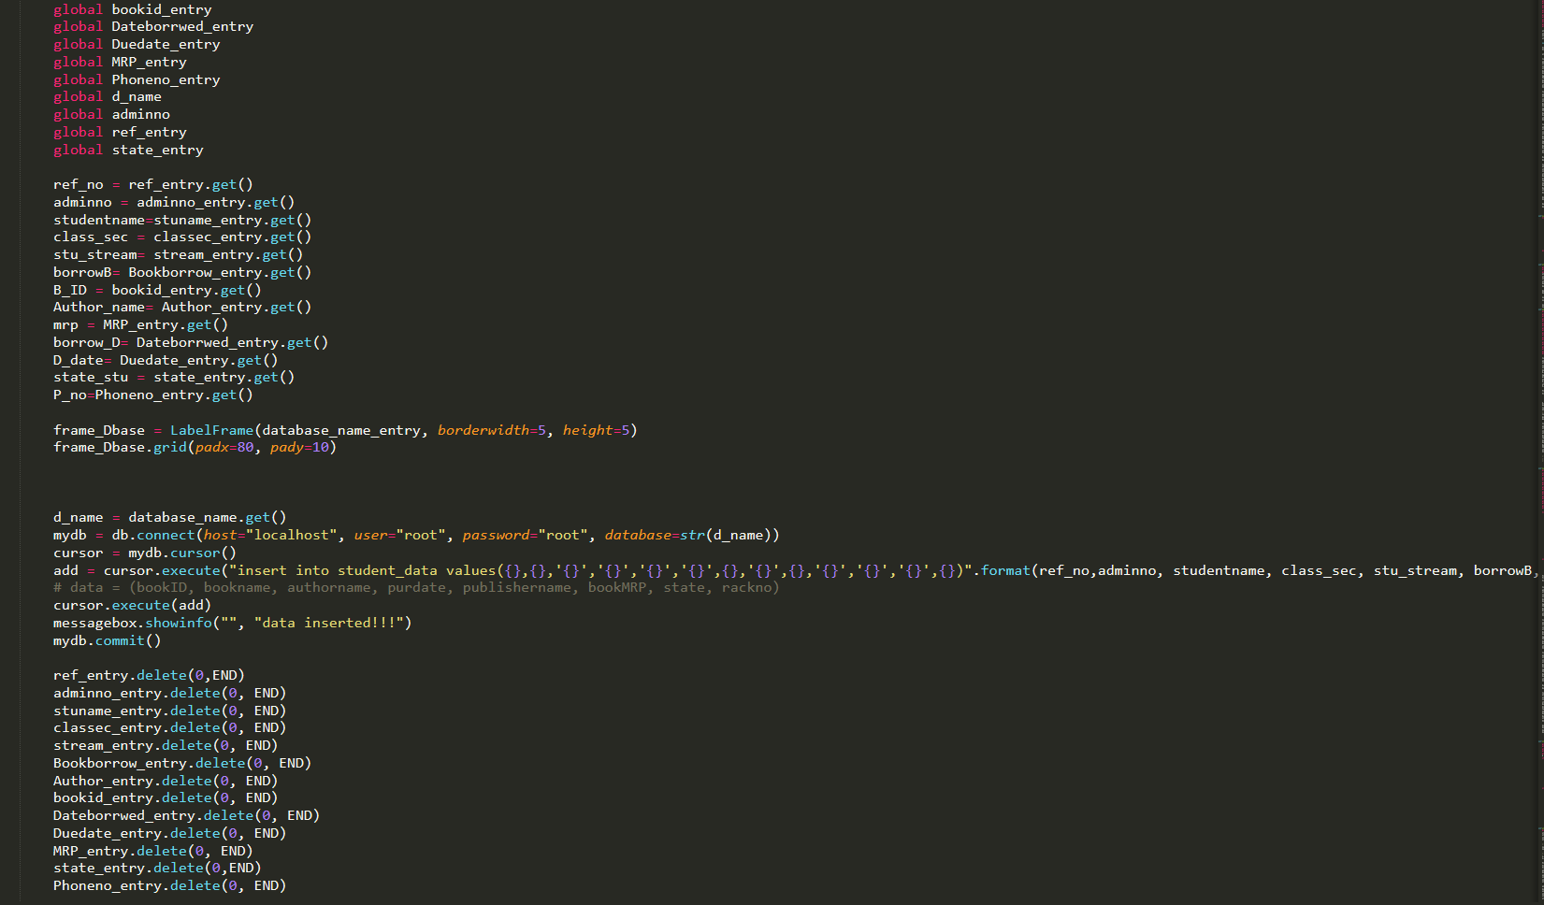

Slide 33
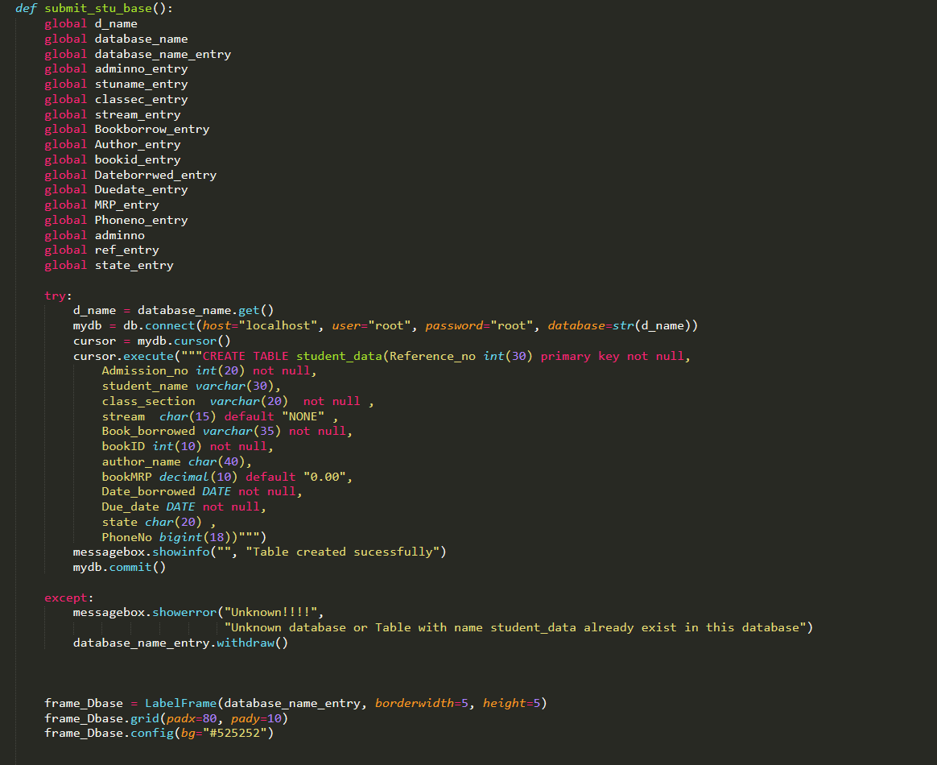

Slide 34
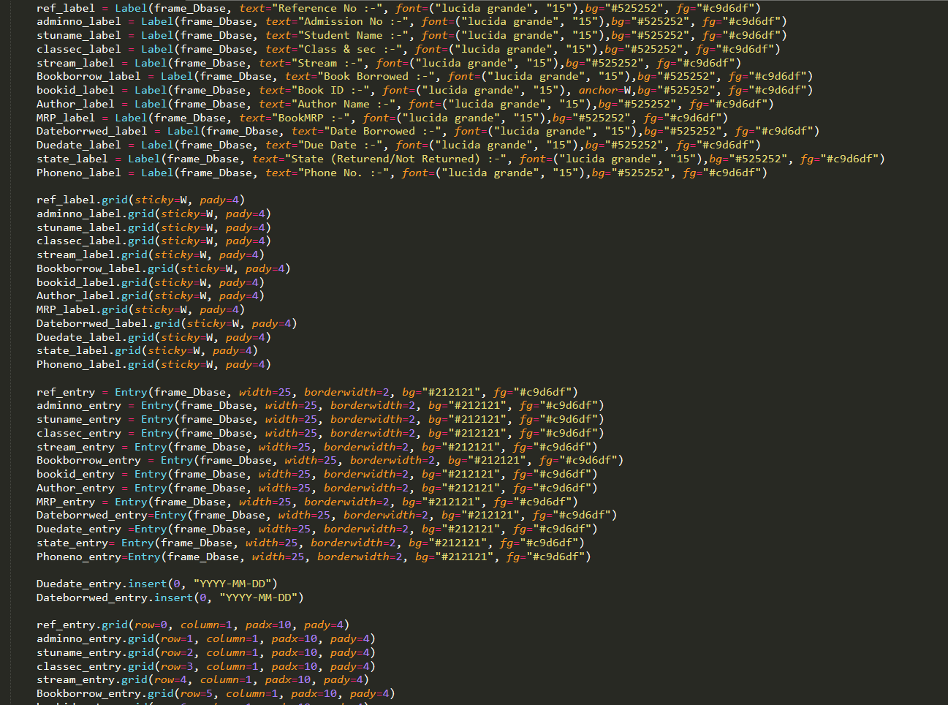

Slide 35
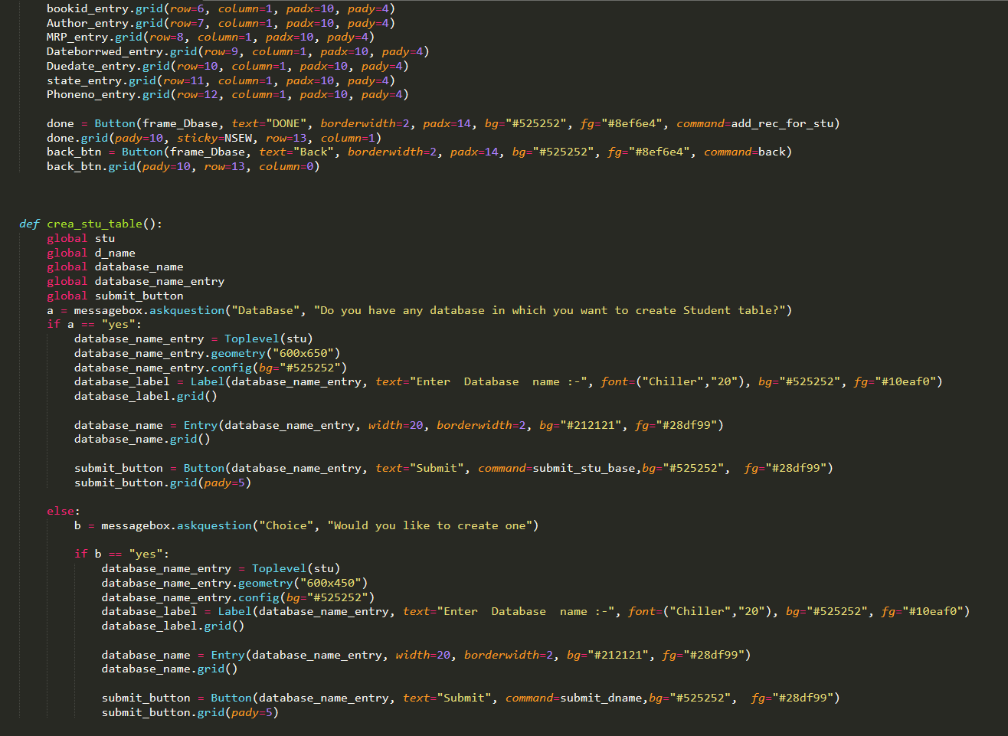

Slide 36
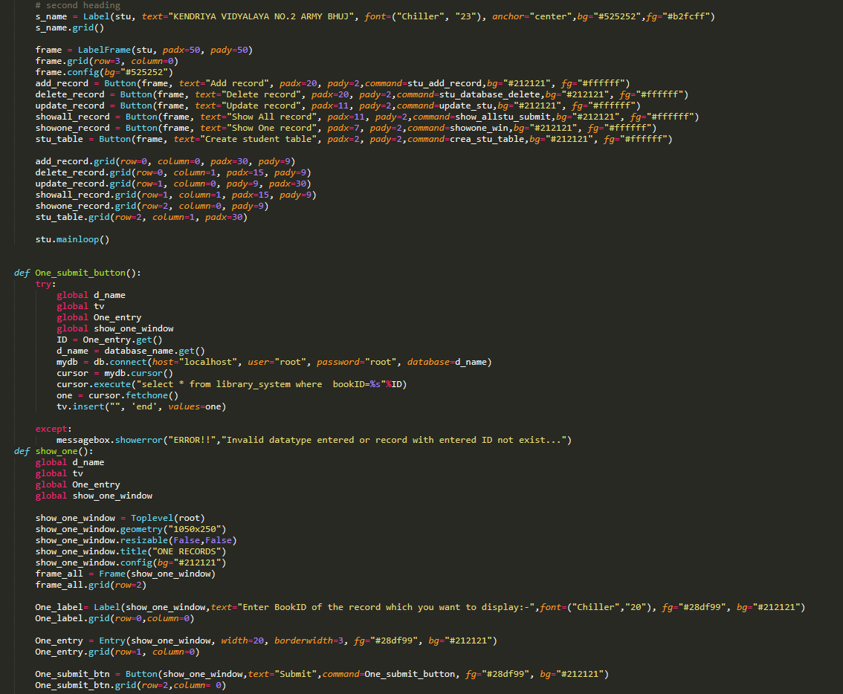

Slide 37
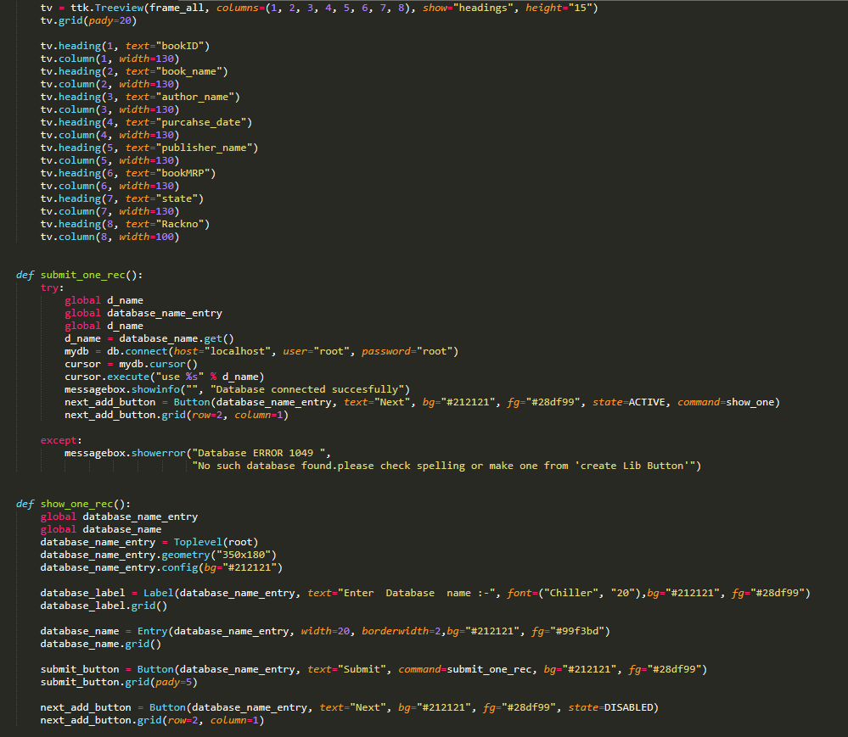

Slide 38
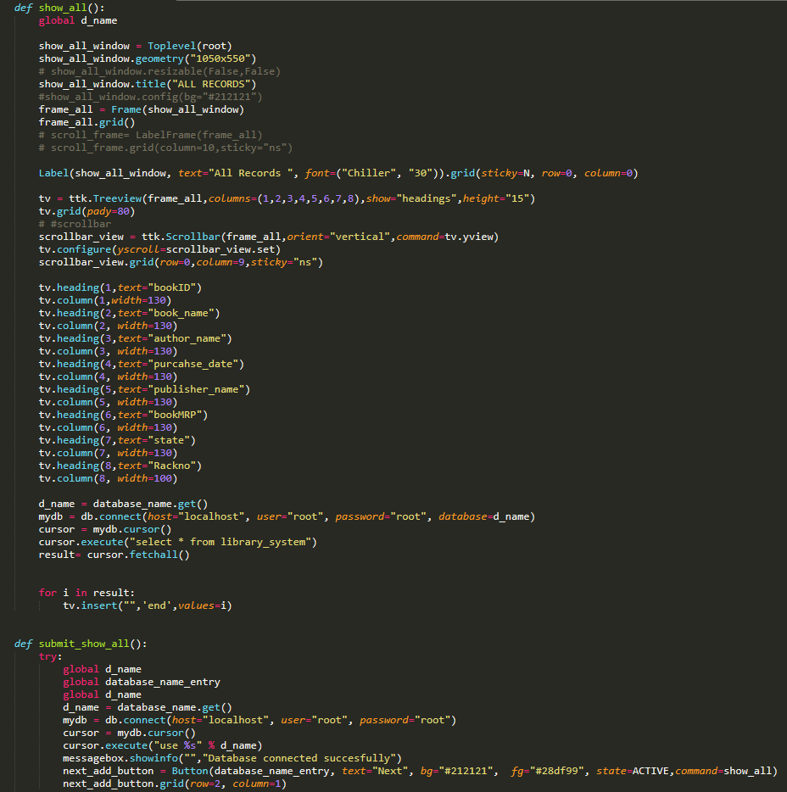

Slide 39
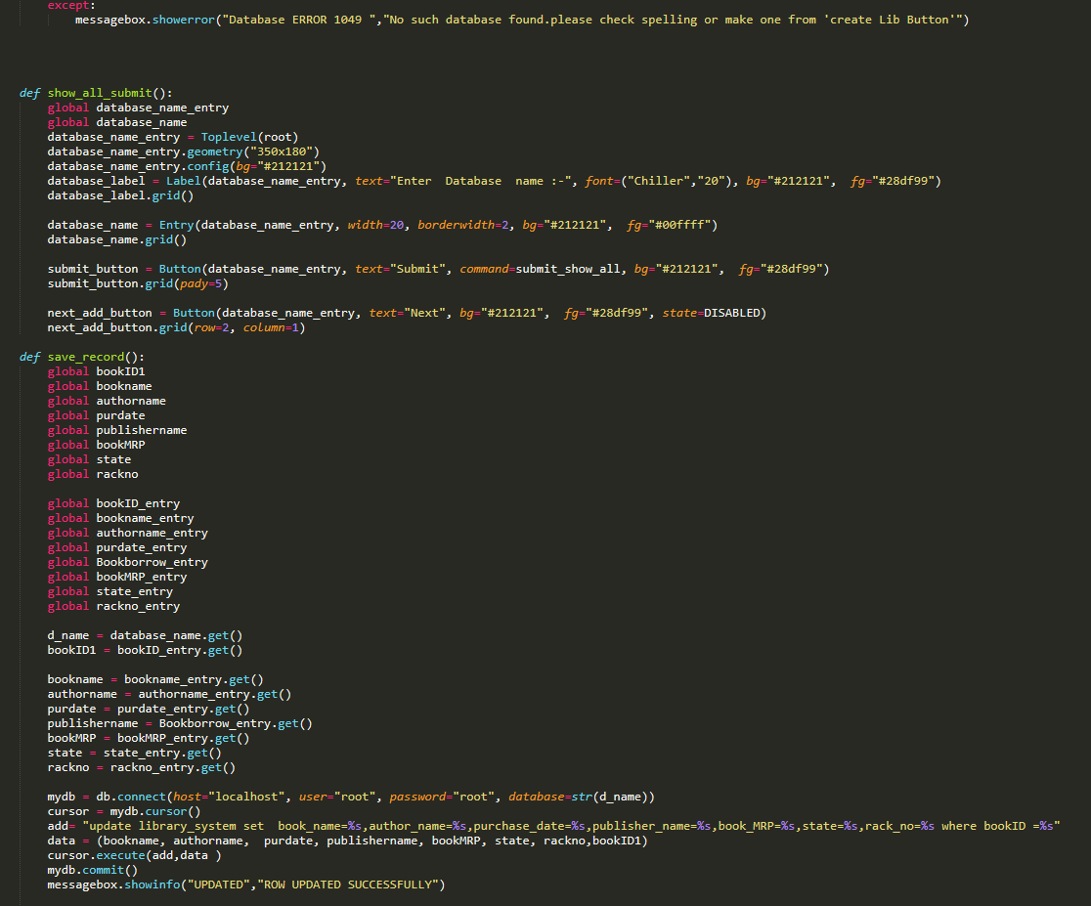

Slide 40
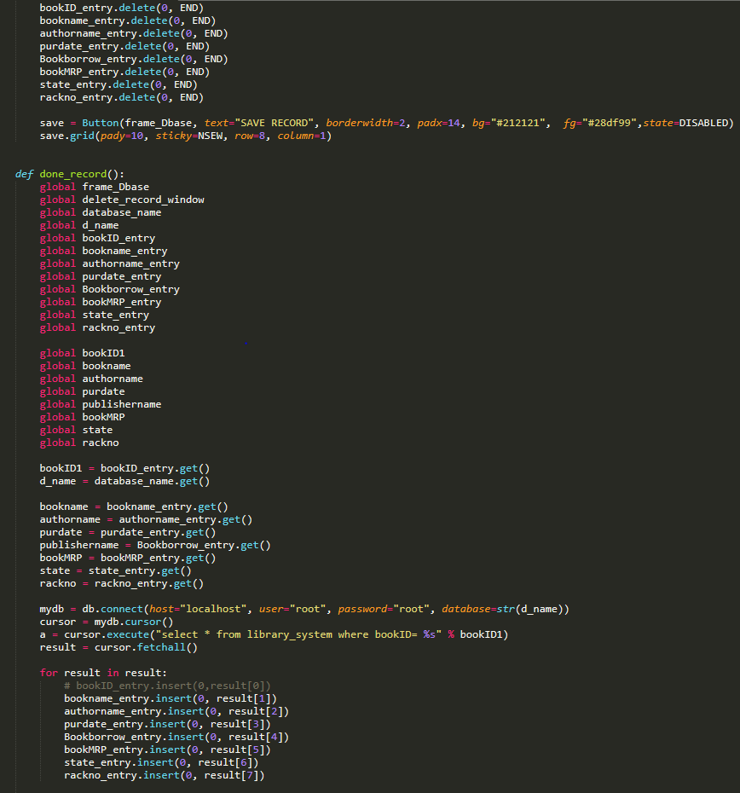

Slide 41
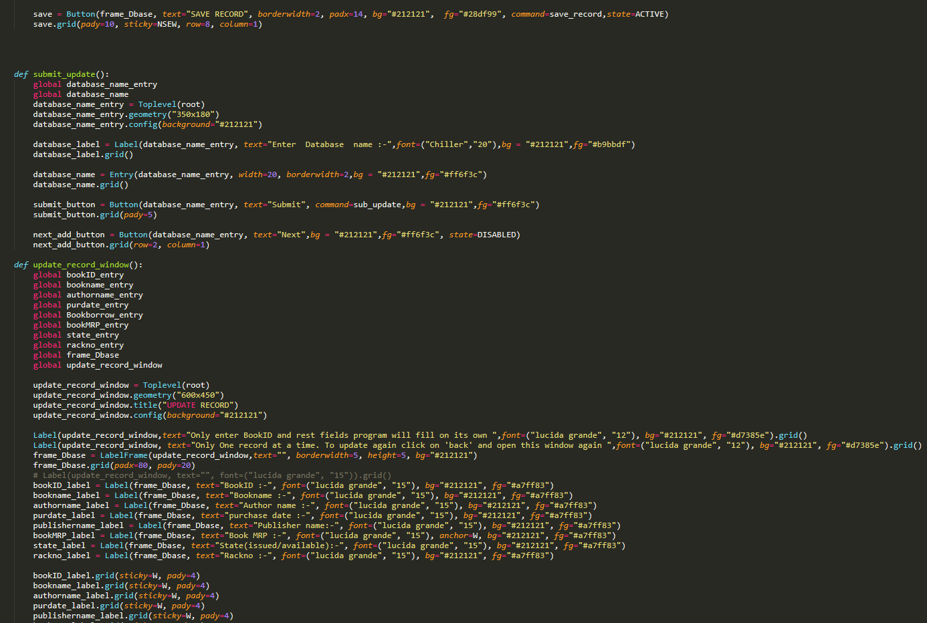

Slide 42
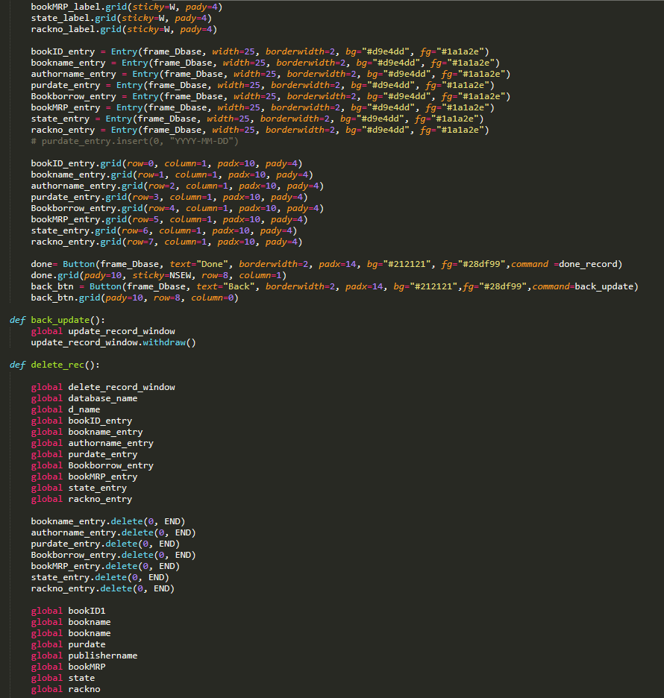

Slide 43
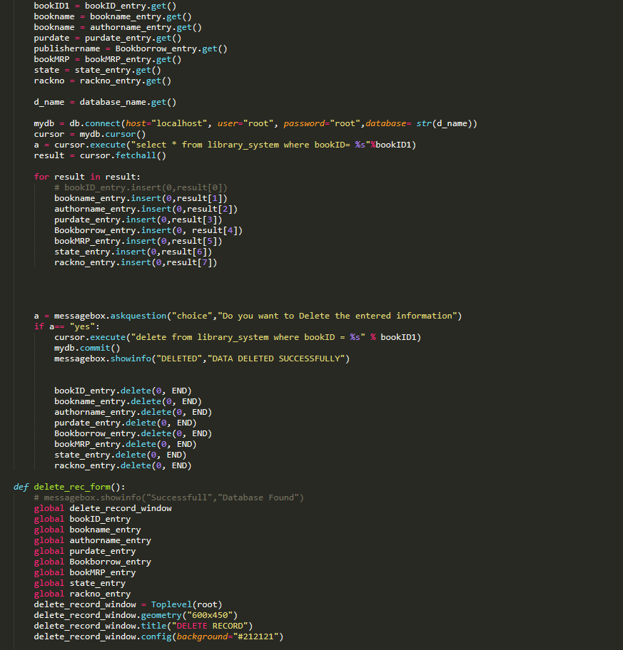

Slide 44
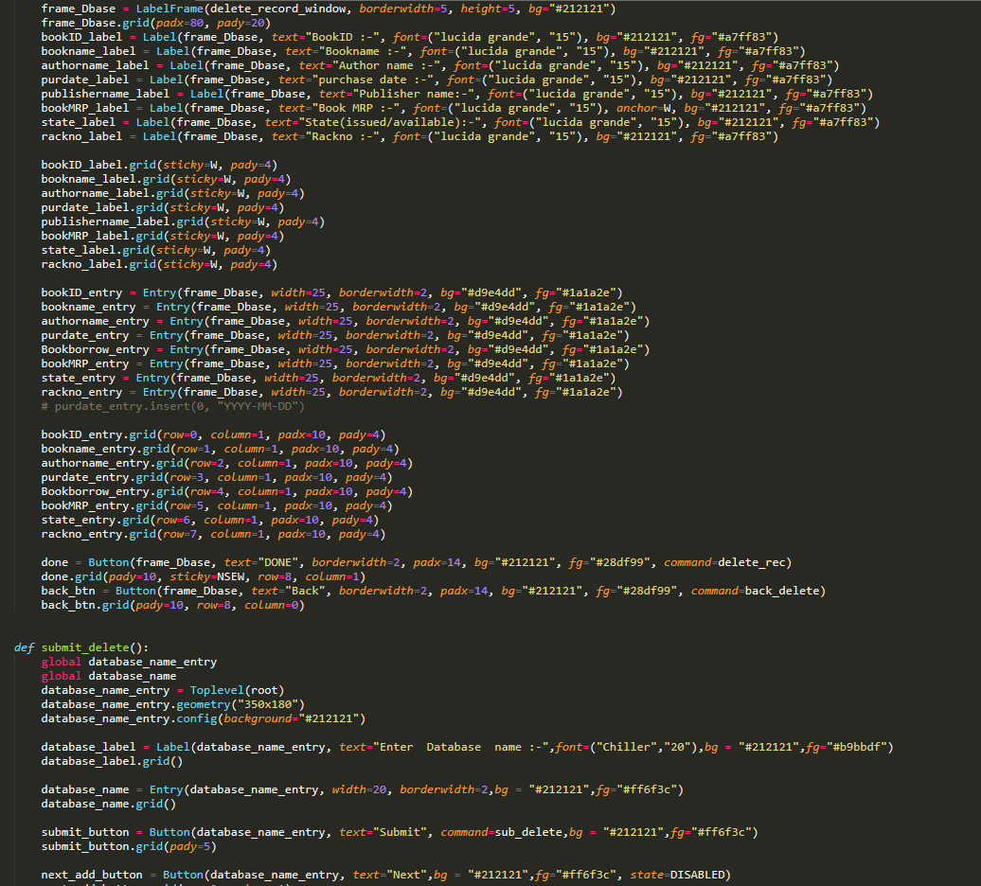

Slide 45
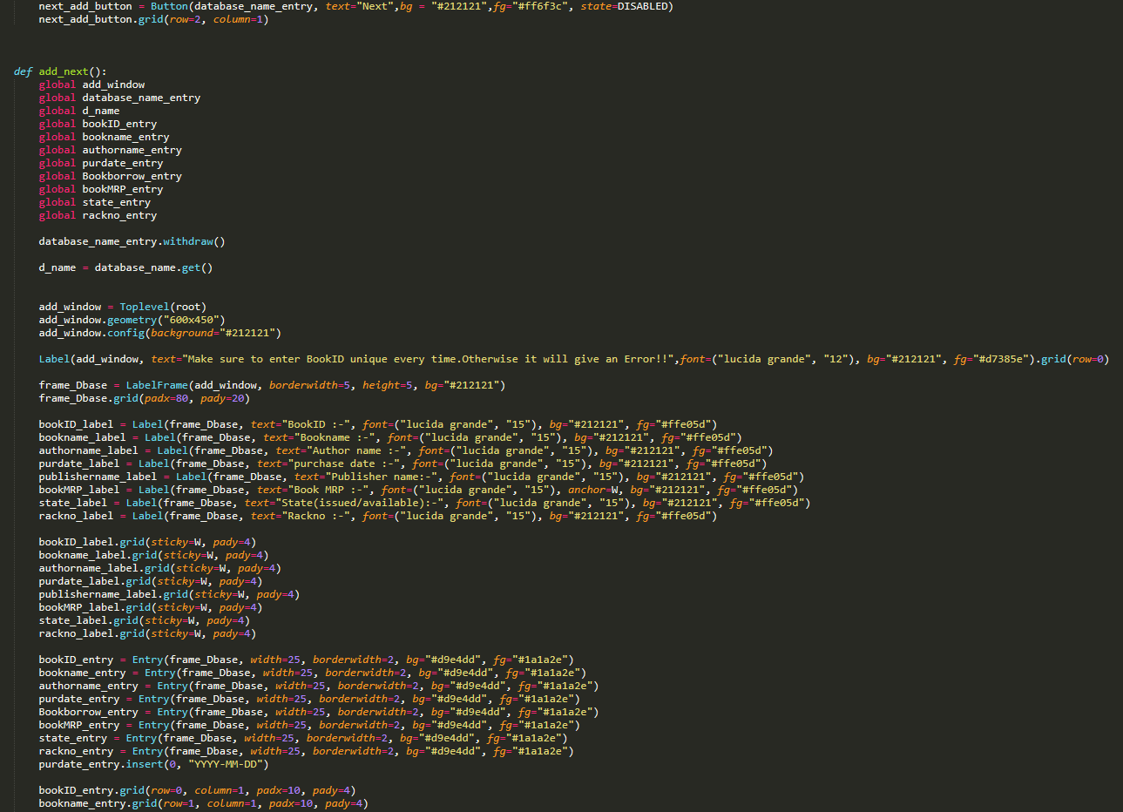

Slide 46
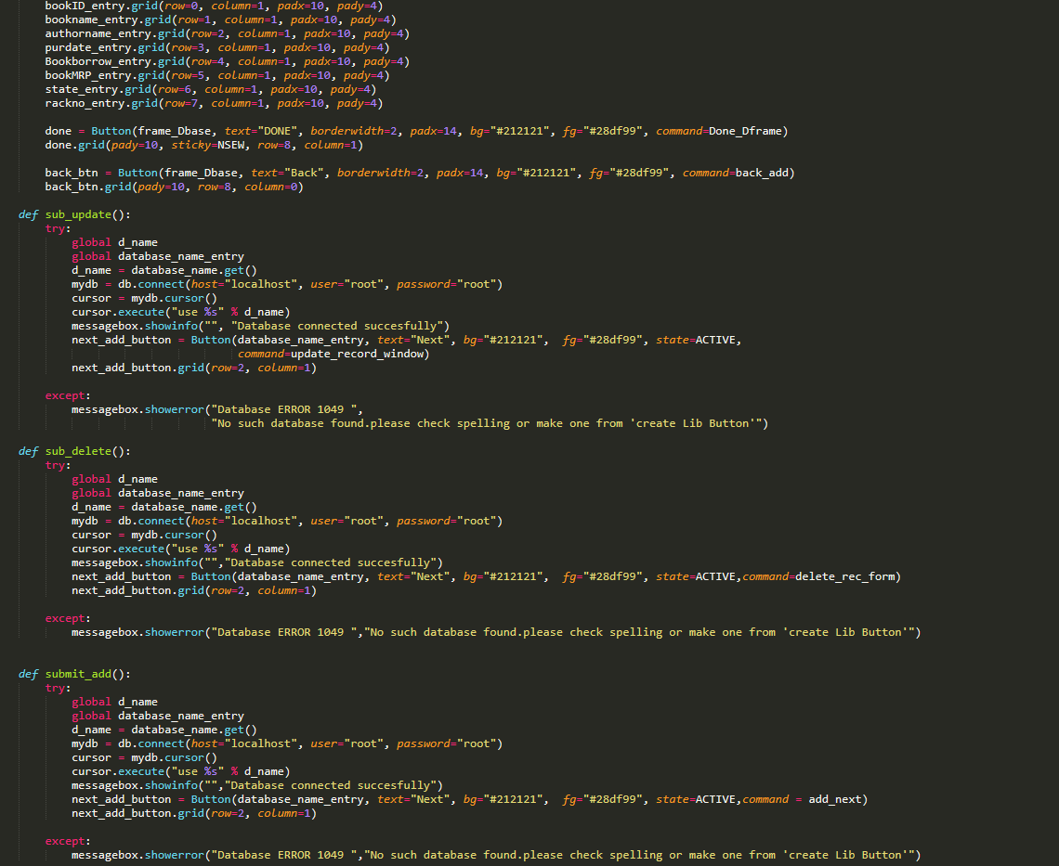

Slide 47
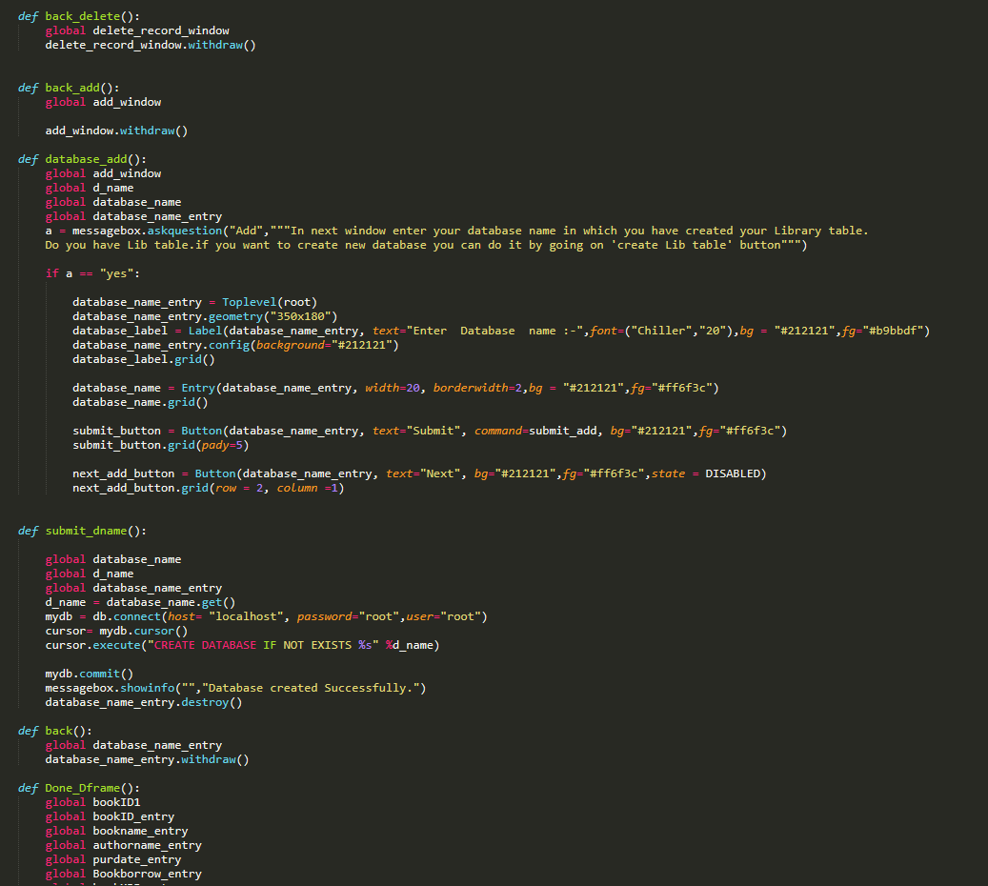

Slide 48
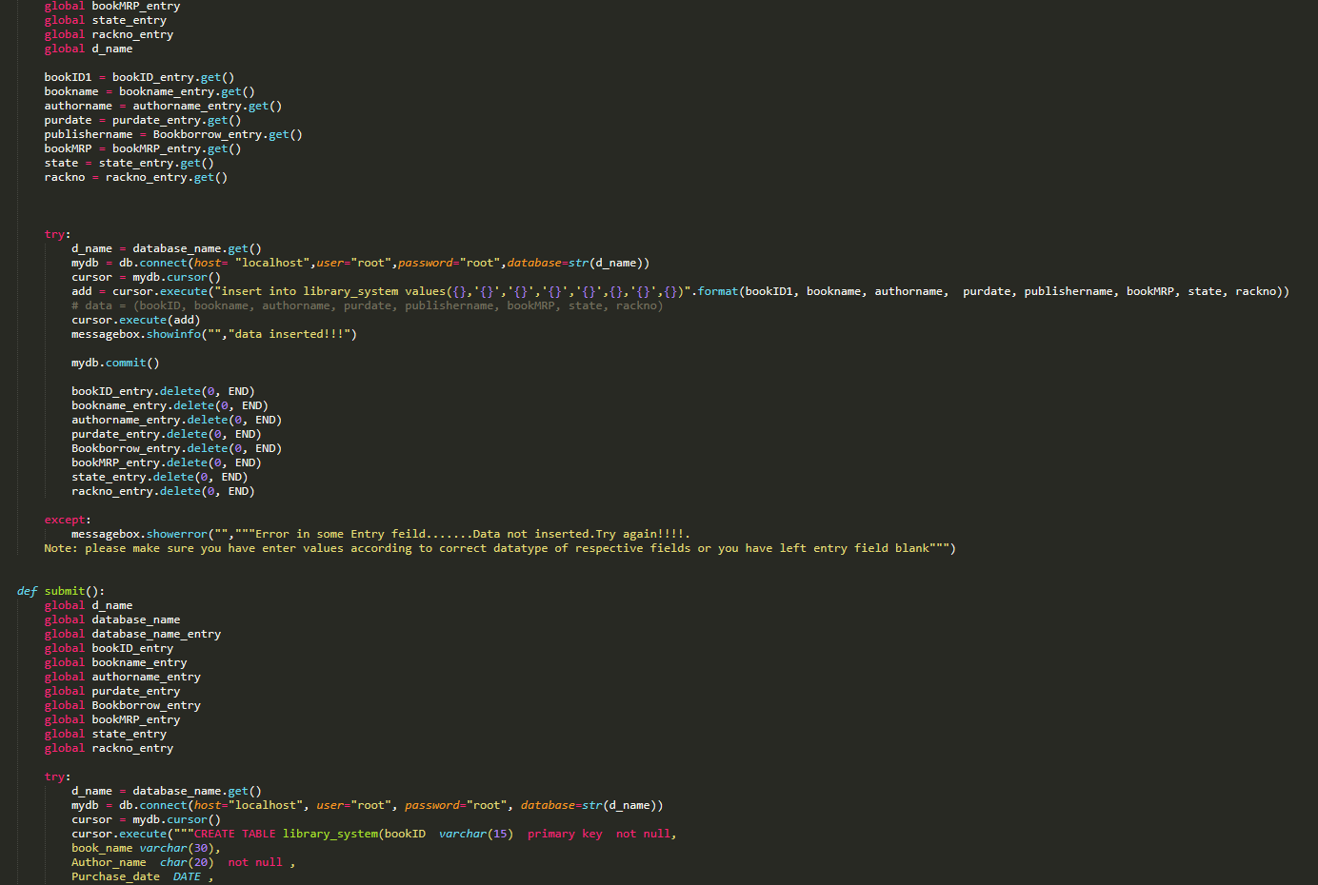

Slide 49
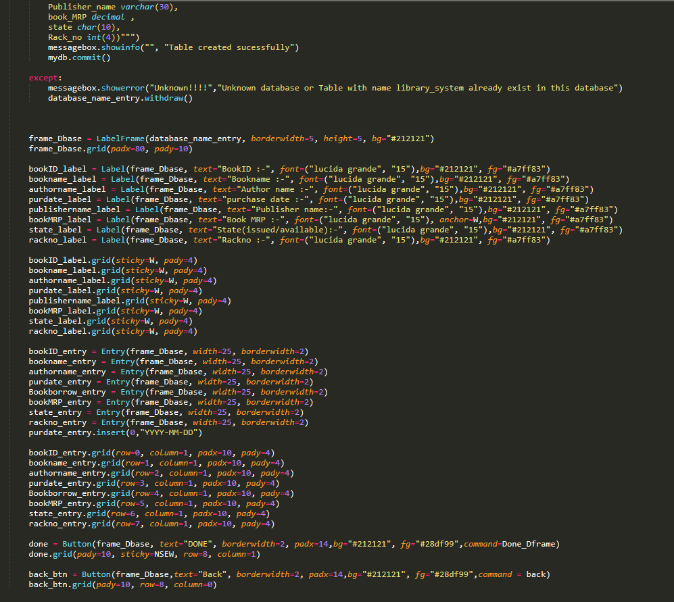

Slide 50
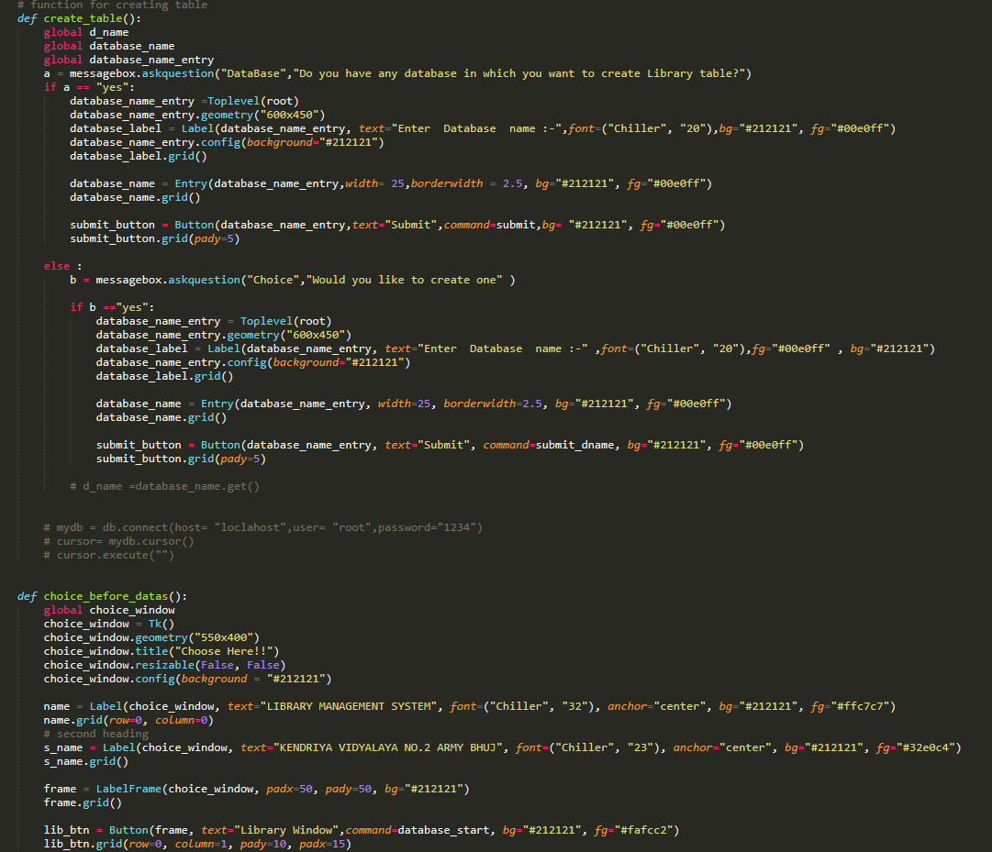

Slide 51
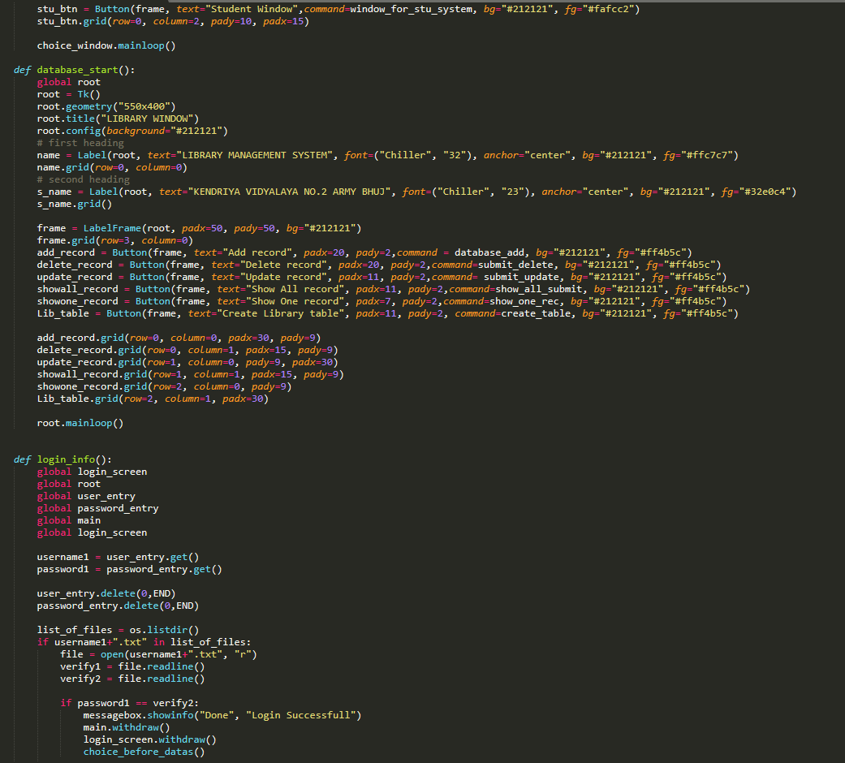

Slide 52
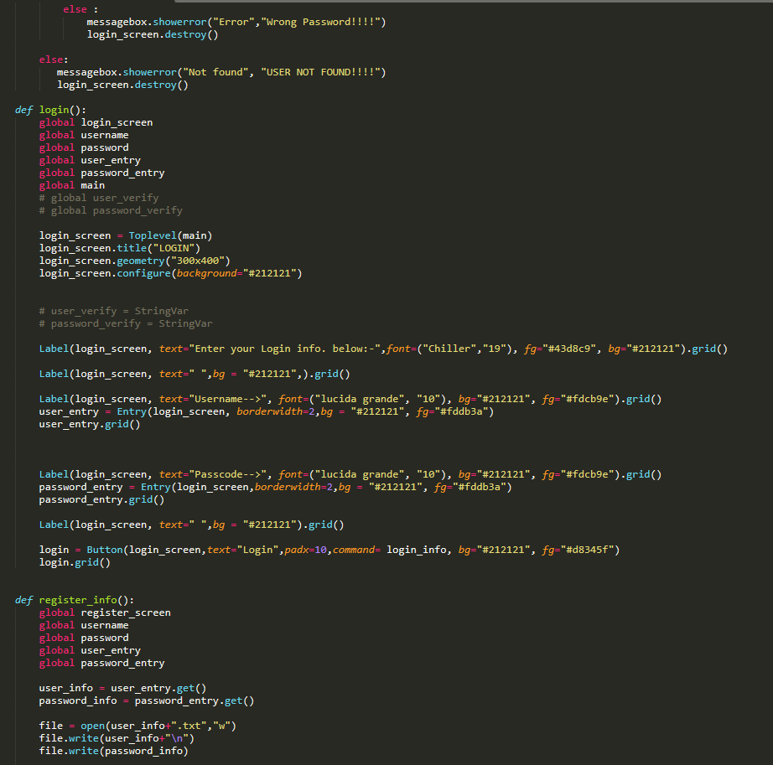

Slide 53
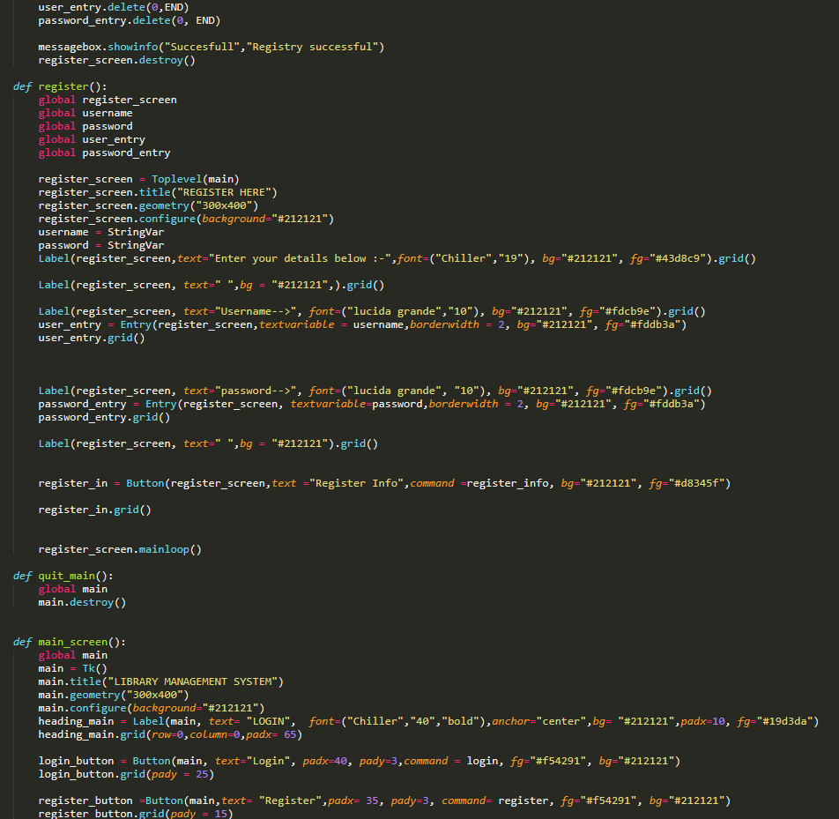

Slide 54
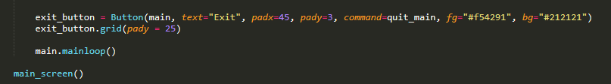

Slide 55
05
OUTPUTS
Python
Introduction
Requirements
Python Coding
Outputs
Bibliography
Project Schedule
Project Timeline
Status Report
Upcoming Report
START

Slide 56
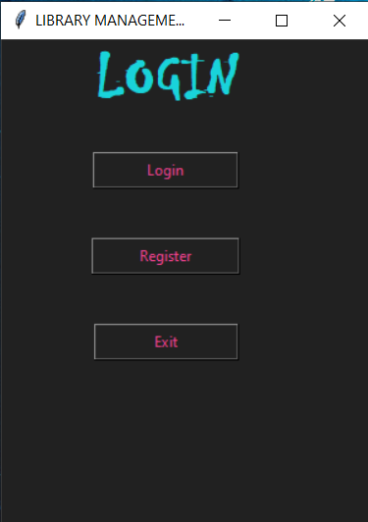
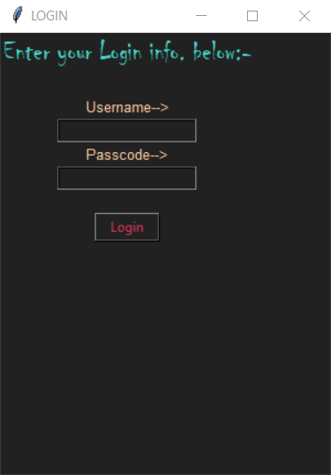
Login Screen

Slide 57
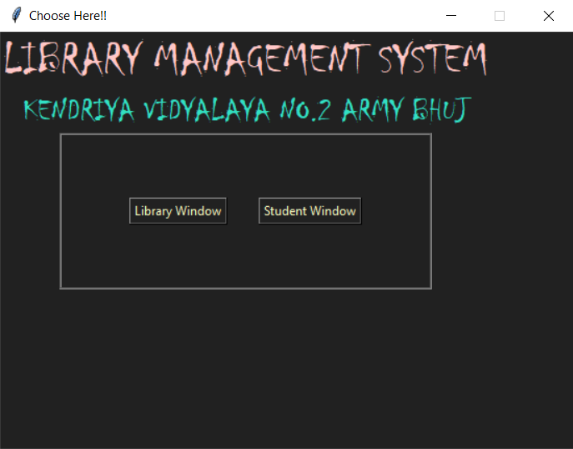
Main Screen

Slide 58
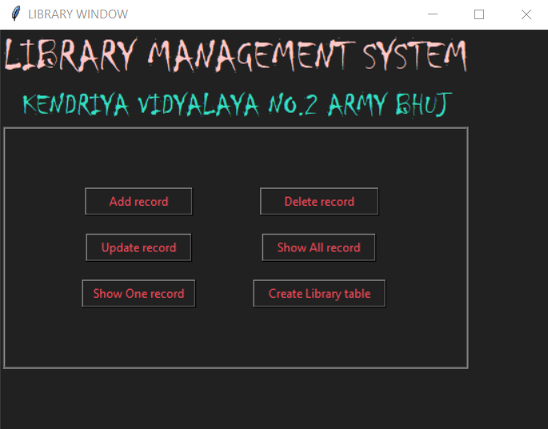
Library Main Screen

Slide 59
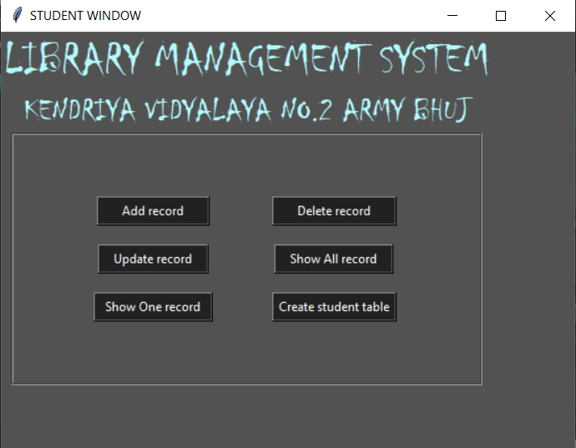
Student Main Screen

Slide 60


Add Details
Library
Student

Slide 61


Update Details
Student
Library

Slide 62


Show details
Library
Student
Once at a Time

Slide 63


Library
Student
All at Once

Slide 64


Delete Details
Student
Library

Slide 65


Create Database or Table Window

Slide 66
06
Bibilography
Python
Introduction
Requirements
Python Coding
Outputs
Project Schedule
Project Timeline
Status Report
Bibliography
Upcoming Report
START

Slide 67
Refrences
C.S Teacher
Python
Introduction
Requirements
Python Coding
Outputs
Bibliography
Project Schedule
Project Timeline
Status Report
Upcoming Report
https://www.google.com/
https://pythontrends.worpress.com/
Computer Science with Python By Sumita Arora
B.L Kashyap

